Slide 1




Deep Dive: Modernize your Oracle workloads to Azure SQL
Alexandra Ciortea
September 15, 9:00 AM PT
HOSTED BY Anna Hoffman @AnalyticAnna
Streaming on LearnTV, YouTube, Twitch & Twitter

Slide 2
Agenda
Migration Drivers
Database Migration
Apps Migration

Slide 3

Drivers
Notes:
https://github.com/microsoft/DataMigrationTeam/blob/master/Whitepapers/Steps%20to%20Run%20SSMA%20for%20Oracle%20-%20Including%20Data%20Migration%20v1.0.pdf
https://github.com/Microsoft/DataMigrationTeam/blob/master/Whitepapers/Steps%20to%20Run%20SSMA%20for%20Oracle%20-%20Including%20Data%20Migration%20v1.0.pdf

Slide 4
Migrations Drivers
Cost Optimization
Application and Database modernization
Performance improvements
Cloud- first mindset
Avoid vendor lock-in
Administrative overhead
Notes:
Companies that embrace the cloud grow 19.6% faster
More than 80% of organizations now adopt cloud-first strategies
Rationale for migrating
Azure SQL Database is a relational database service hosted in the Microsoft Cloud that is based on the market-leading Microsoft SQL Server engine. Azure SQL Database is capable of handling mission-critical workloads and delivers predictable performance at multiple service levels, dynamic scalability with no downtime, built-in business continuity, and data protection — all with near-zero administration.
These capabilities allow you to focus on rapid app development and accelerating your time-to-market, rather than allocating precious time and resources to managing virtual machines and infrastructure. Based on the SQL Server engine, Azure SQL Database supports existing SQL Server tools, libraries, and APIs. This makes it is easy for you to develop new solutions, to move your existing SQL Server solutions, and to extend your existing SQL Server solutions to the Microsoft Cloud without having to learn new skills.
Consider the detail in the following sections when evaluating the rationale for migrating.
Performance and scale without downtime
The Azure SQL Database service offers multiple service tiers (Basic, Standard, Premium, and Premium RS), and each tier provides different levels of performance and capabilities to support lightweight to heavyweight database workloads. You can change tiers manually or programmatically at any time to meet the needs of your solution, and you can do this without downtime to your app or to your customers. Dynamic scalability enables your database to transparently respond to rapidly changing resource requirements and lets you pay for the resources you need when you need them.
Use elastic pools to maximize resource utilization
For businesses and applications with relatively unpredictable usage patterns, it can be hard to manage costs and the associated business model. Elastic pools are designed to solve this problem by allowing you to allocate performance resources to a pool rather than to an individual database. Customers pay for the collective performance resources of the pool rather than for single database performance. With elastic pools, you don’t need to dial database performance up and down as demand for resources fluctuates. The pooled databases consume the performance resources of the elastic pool as needed.
Blend single databases with pooled databases
Either way you go — single databases or elastic pools — you are not locked in. You can blend single databases with elastic pools, and change the service tiers of single databases and elastic pools quickly and easily to adapt to your situation. Moreover, with the power and reach of Azure, you can mix-and-match other Azure services with SQL Database to meet your unique app design needs, drive cost and resource efficiencies, and unlock new business opportunities.
Monitoring and alerting
You use the built-in performance monitoring and alerting tools, combined with the performance ratings based on Database Transaction Units (DTUs) for single databases and elastic DTUs (eDTUs) for elastic pools, to quickly assess the impact of scaling up or down based on your current or project performance needs. See SQL Database options and performance: Understand what's available in each service tier for details.
Keeping your app and business running
Azure's industry leading 99.99% availability service level agreement (SLA), powered by a global network of Microsoft-managed datacenters, helps keep your app running 24/7. Every Azure SQL database takes advantage of built-in security, fault tolerance, and data protection that customers would otherwise have to buy or design, build, and manage.
Securing your data
SQL Server has a tradition of data security that Azure SQL Database upholds with features that limit access, protect data, and help you monitor activity. See Securing your SQL database for a quick rundown of security options available in SQL Database.
https://datamigration.microsoft.com/scenario/oracle-to-azuresqldb?step=1

Slide 5
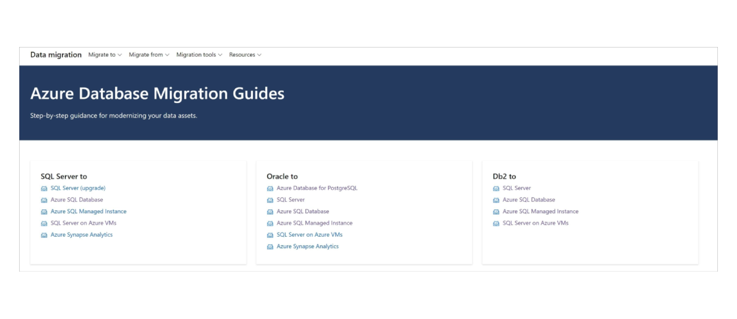
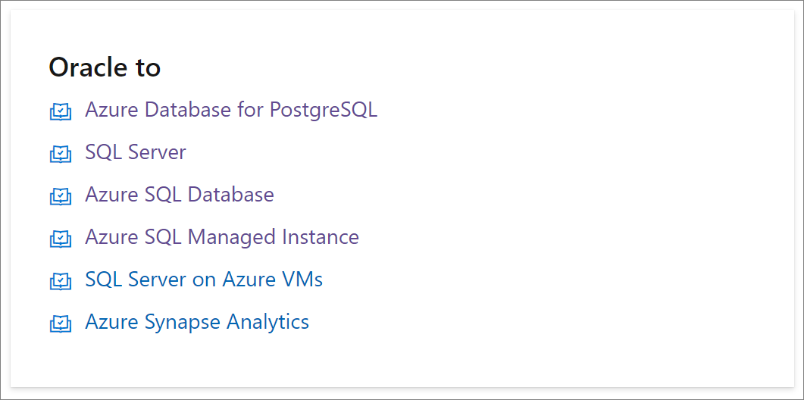
Oracle migration options
datamigration.microsoft.com

Slide 6
Why Azure SQL ?
Breakthrough productivity & performance
Industry-leading security
Built-in intelligence
Seamless and compatible
Competitive TCO
Layers of security and 99.99 percent availability SLA
Intelligent performance tuning and intelligent protection
The broadest SQL Server compatibility and VNET support
Up to 80% savings with Azure Hybrid Benefit and reserved capacity
The best and most economical cloud destination
Notes:
Breakthrough productivity & performance
Experience up to 30x improved throughput and latency and up to 100x faster queries and reports with in-memory technologies.¹ In-memory OLTP can dramatically improve throughput and latency on transactional processing workloads and can provide significant performance improvements.
Dynamic scalability enables your database to transparently respond to rapidly changing resource requirements across all service tiers: Basic, Standard, Premium (Single databases and elastic pools); General Purpose and Business Critical (Managed Instance). Scale your app from a handful of databases to thousands and manage unpredictable demand patterns, within a budget and resources you control with elastic pools.
Support for 100TB+ databases with Hyperscale
Industry-leading security
Protect sensitive data with Transparent Data Encryption and Dynamic Data Masking
Proactively monitor for vulnerabilities and threats with intelligent Advanced Threat Protection
Enable database access control with multifactor authentication using Azure Active Directory authentication. You can centrally manage the identities of database users and other Microsoft services in a single location. Central identity management provides a single place to manage Azure SQL Database users and simplifies permission management.
Built-in Intelligence
Intelligent Performance learns unique database patterns and automatically tunes for improved performance
Adaptive Query Processing. Accelerate parallel queries and improve scaling of frequent queries with Intelligent Query Processing

Slide 7

Migration Phases

Slide 8
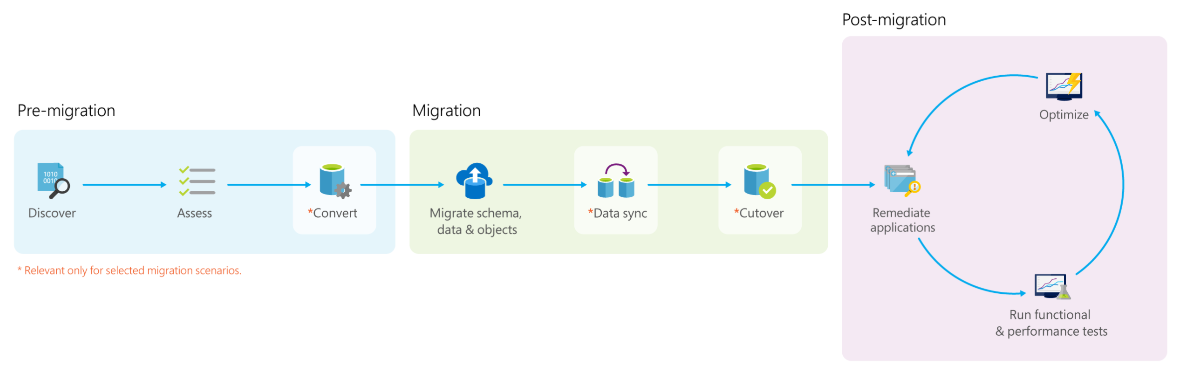
Migration Process Overview
Oracle Inventory Scripts
SSMA for Oracle
SSMA/ SSIS/ ADF/ 3rd party
SSMA for Oracle/ DAMT

Slide 9
SQL Server Migration Assistant for Oracle (OracleToSQL)
Supported Targets:​ SQL Server 2012​ and above, Azure SQL
Converts Oracle database objects to SQL Server database objects
Migrates data from Oracle to SQL Server
Validates migrated data and objects
Notes:
https://docs.microsoft.com/en-us/sql/ssma/oracle/sql-server-migration-assistant-for-oracle-oracletosql?view=sql-server-ver15

Slide 10
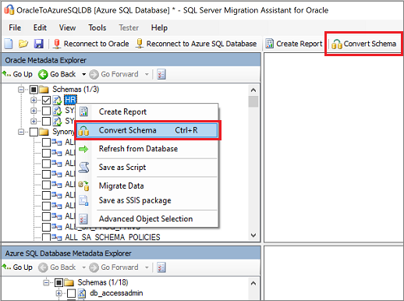
Recommended Migration Process
Create
Create a new SSMA project
Connect
Connect to the Oracle database server
Connect
Connect to an instance of SQL Server
Map
Map Oracle database schemas to SQL Server database schemas
Create
Optionally, Create assessment reports
Convert
Convert Oracle database schemas into SQL Server schemas
Load
Load the converted database objects into SQL Server
Migrate
Migrate data to SQL Server
Update
If necessary, update database applications
Notes:
SQL Server Migration Assistant (SSMA) for Oracle is a comprehensive environment that helps you quickly migrate Oracle databases to SQL Server, Azure SQL Database, or Azure Synapse Analytics. By using SSMA for Oracle, you can review database objects and data, assess databases for migration, migrate database objects to SQL Server, Azure SQL Database, or Azure Synapse Analytics, and then migrate data to SQL Server, Azure SQL Database, or Azure Synapse Analytics. Note that you cannot migrate SYS and SYSTEM Oracle schemas.
https://docs.microsoft.com/en-us/sql/ssma/oracle/migrating-oracle-databases-to-sql-server-oracletosql?view=sql-server-ver15

Slide 11
Demo
SSMA for Oracle
Migration Process Walkthrough
Notes:
https://github.com/microsoft/DataMigrationTeam/blob/master/Whitepapers/Steps%20to%20Run%20SSMA%20for%20Oracle%20-%20Including%20Data%20Migration%20v1.0.pdf
https://github.com/Microsoft/DataMigrationTeam/blob/master/Whitepapers/Steps%20to%20Run%20SSMA%20for%20Oracle%20-%20Including%20Data%20Migration%20v1.0.pdf

Slide 12
SSMA Console
Why
Automated conversion & migration
What
How
Invoke using UI project
Separate Application
Large number of schema objects
Console only
Parallel schema conversion
Invoke from scratch
Notes:
Talk about the GUI and command line modes

Slide 13
Data Migration- Offline versus online
For an online migration, downtime is limited to the time required to cut over to the new environment when the migration completes
Test an offline migration to determine whether the downtime is acceptable. If it is not, perform an online migration
When you migrate databases to Azure, you can perform an offline or an online migration
The application downtime begins when the migration starts
Notes:
https://datamigration.microsoft.com/scenario/oracle-to-azuresqldb?step=1

Slide 14
Initial Data Sync
SQL Server Integration Services
SSMA (client side)
Azure Data Factory
SSMA (server side)
Azure Databricks
Databox
Notes:
Through SSMA,automatic schema conversion,customize type mappings and manuel code conversion can be done.
For Data migration Use SSIS:
When out of the box SSMA is not capable of handling migration
For QA and Production migrations where robust capabilities and a repeatable process are required
For large datasets where multiple data flows or scale out may be required
But it requires SSIS dev skills.
For Data Migration CDC can be used for synchronizing source and target databases but requires DBA and dev skills.

Slide 15
Incremental Data Sync
SQL Server Integration Services – CDC component
3rd Party solutions
Azure Data Factory IR
Azure Databricks
Notes:
Through SSMA,automatic schema conversion,customize type mappings and manuel code conversion can be done.
For Data migration Use SSIS:
When out of the box SSMA is not capable of handling migration
For QA and Production migrations where robust capabilities and a repeatable process are required
For large datasets where multiple data flows or scale out may be required
But it requires SSIS dev skills.
For Data Migration CDC can be used for synchronizing source and target databases but requires DBA and dev skills.

Slide 16

Applications Migration

Slide 17
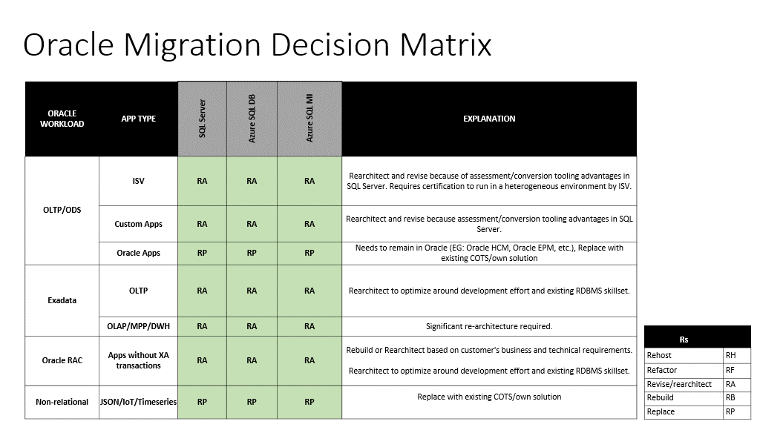

Slide 18
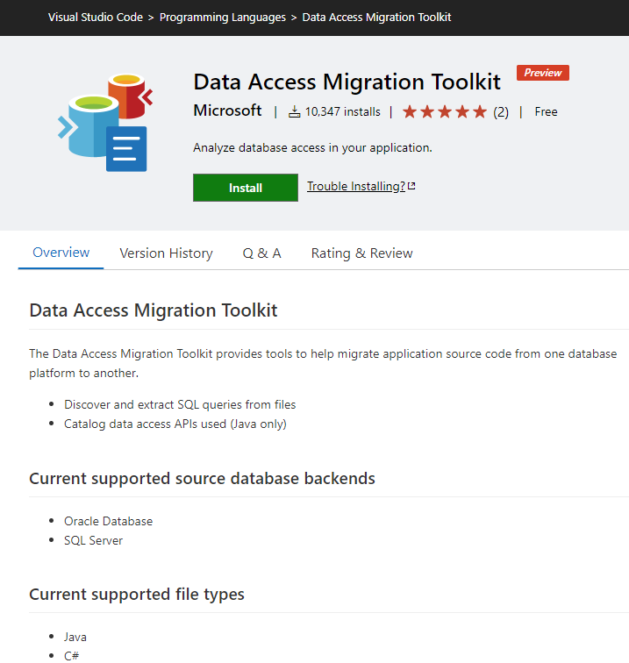
Data Access Migration Toolkit
Tool designed to help migrate application source code from one database platform to another
Scan your entire source code for database usage and SQL queries
Use the tool to find compatibility issues between your application and your Azure SQL

Slide 19
Demo
Data Access Migration Toolkit
Process Walkthrough
Notes:
https://github.com/microsoft/DataMigrationTeam/blob/master/Whitepapers/Steps%20to%20Run%20SSMA%20for%20Oracle%20-%20Including%20Data%20Migration%20v1.0.pdf
https://github.com/Microsoft/DataMigrationTeam/blob/master/Whitepapers/Steps%20to%20Run%20SSMA%20for%20Oracle%20-%20Including%20Data%20Migration%20v1.0.pdf

Slide 20
Post-migration
Remediate applications
Perform tests
Optimize
Redirect Applications
Notes:
After you have successfully completed the Migration stage, you need to go through a series of post-migration tasks to ensure that everything is functioning as smoothly and efficiently as possible.
Remediate applications
After the data is migrated to the target environment, all the applications that formerly consumed the source need to start consuming the target. Accomplishing this will in some cases require changes to the applications.
Perform tests
The test approach for database migration consists of performing the following activities:
1.Develop validation tests. To test database migration, you need to use SQL queries. You must create the validation queries to run against both the source and the target databases. Your validation queries should cover the scope you have defined.
2.Set up test environment. The test environment should contain a copy of the source database and the target database. Be sure to isolate the test environment.
3.Run validation tests. Run the validation tests against the source and the target, and then analyze the results.
4.Run performance tests. Run performance test against the source and the target, and then analyze and compare the results.
Optimize
The post-migration phase is crucial for reconciling any data accuracy issues and verifying completeness, as well as addressing performance issues with the workload.
https://datamigration.microsoft.com/scenario/oracle-to-azuresqldb?step=3&tabnav=true

Slide 21
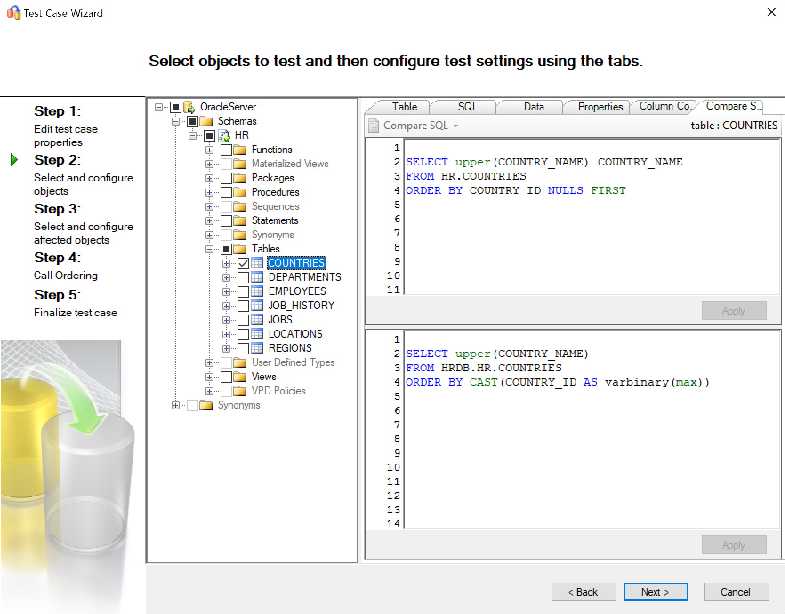
SSMA Tester – Validate Migrated objects
Tables
Stored procedures
User-defined functions
Views
Standalone statements
Notes:
Migrating to SQL: Validate Migrated Object Using SSMA | Data Exposed | Channel 9 (msdn.com)

Slide 22
Questions? To interact with us, head over to aka.ms/LearnTV

Slide 23
@AzureSQL
Want more: aka.ms/dataexposedlive
aka.ms/dataexposedyt

Slide 24

Thank you!

